Slide 1

Source- Download PDF - Data Structures-trees.ppt [k546ywkkr9n8] (idoc.pub)

Slide 2

▣ Chapter 10. Data Abstraction & Problem Solving with C++, Fifth Edition. by Frank M. Carrano

Slide 3

▣ Trees are composed of nodes and edges
▣ Trees are hierarchical
Parent-child relationship between two nodes
Ancestor-descendant relationships among nodes
▣ Subtree of a tree: Any node and its descendants

Slide 4
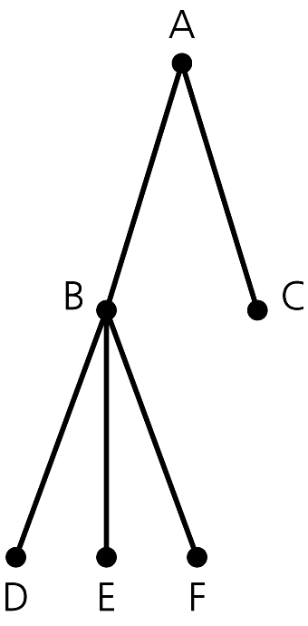
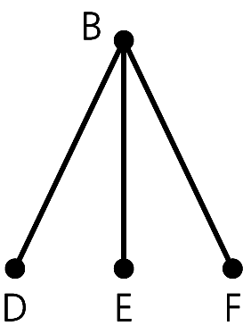
Figure 10-2
Figure 10-1 A general tree
A subtree of the tree in Figure 10-1

Slide 5
▣ General tree
A general tree T is a set of one or more nodes such
that T is partitioned into disjoint subsets:
  A single node r, the root
  Sets that are general trees, called subtrees of r

Slide 6
▣ Parent of node n
The node directly above node n in the tree
▣ Child of node n
A node directly below node n in the tree
▣ Root
The only node in the tree with no parent
▣ Subtree of node n
A tree that consists of a child (if any) of node n and the
child’s descendants

Slide 7
▣ Leaf
A node with no children
▣ Siblings
Nodes with a common parent
▣ Ancestor of node n
A node on the path from the root to n
▣ Descendant of node n
A node on a path from n to a leaf

Slide 8

▣ A binary tree is a set T of nodes such that either
T is empty, or
T is partitioned into three disjoint subsets:
  A single node r, the root
  Two possibly empty sets that are binary trees, called
the left subtree of r and the right subtree of r

Slide 9

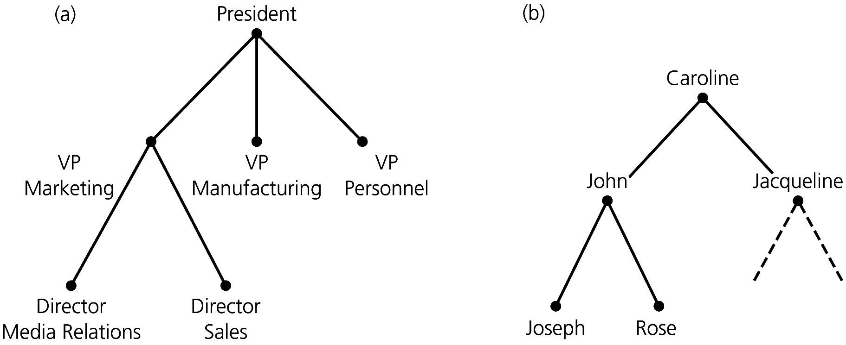
Figure 10-3 (a) An organization chart; (b) a family tree

Slide 10

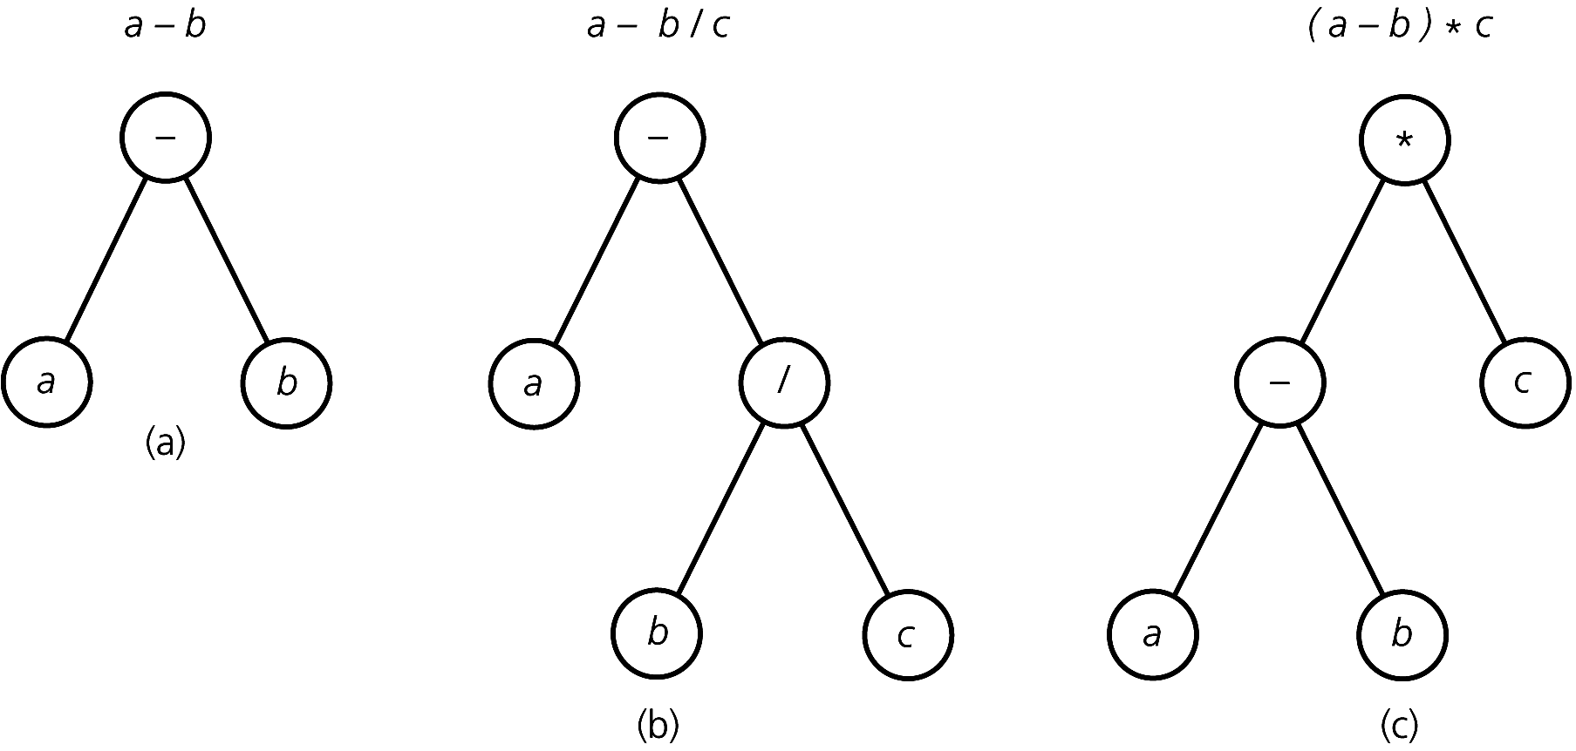
Figure 10-4 Binary trees that represent algebraic expressions

Slide 11

▣ A binary search tree
A binary tree that has the following properties for
each node n
  n’s value is > all values in n’s left subtree T_{L}
  n’s value is < all values in n’s right subtree T_{R}
  Both T_{L} and T_{R} are binary search trees

Slide 12
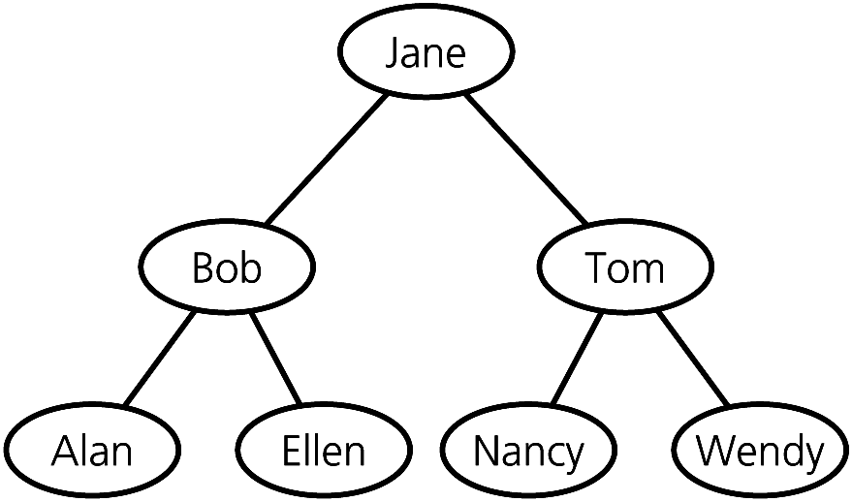
Figure 10-5
A binary search tree of names

Slide 13

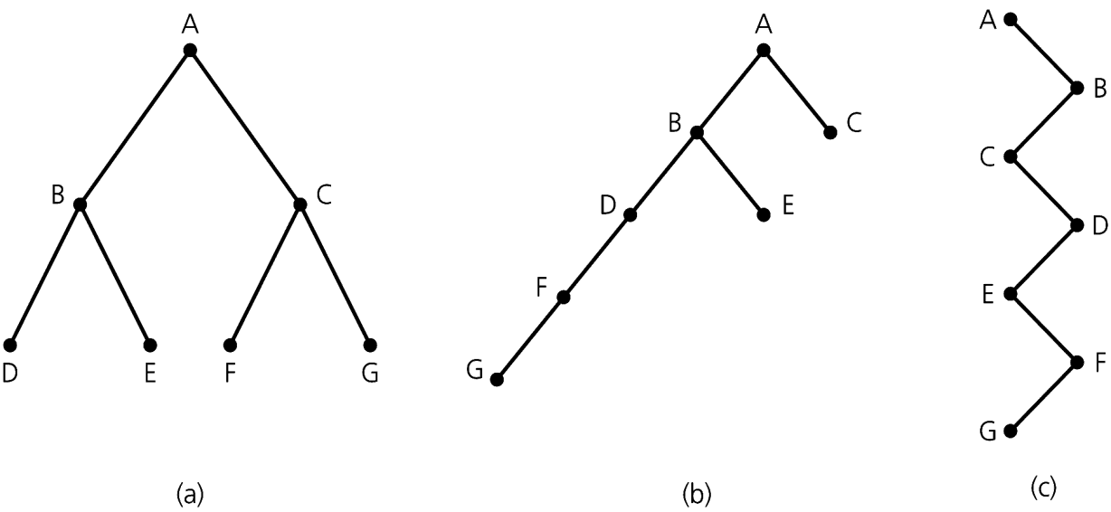
▣ Height of a tree
Number of nodes along the longest path from the
root to a leaf
Height 3 Height 5 Height 7
Figure 10-6
Binary trees with
the same nodes but different heights

Slide 14
▣ Level of a node n in a tree T
If n is the root of T, it is at level 1
If n is not the root of T, its level is 1 greater than the level of its parent
▣ Height of a tree T defined in terms of the levels of its nodes
If T is empty, its height is 0
If T is not empty, its height is equal to the maximum
level of its nodes

Slide 15

▣ A recursive definition of height
If T is empty, its height is 0
If T is not empty,
height(T) = 1 + max{height(T_{L}), height(T_{R})}
r
/ \
T_{L} T_{R}

Slide 16


▣ A binary tree of height h is full
if
Nodes at levels < h have two children each
▣ Recursive definition
If T is empty, T is a full binary tree of height 0
If T is not empty and has height h
> 0, T is a full binary tree if its root’s subtrees are both full binary trees of height h – 1
Figure 10-7
A full binary tree of height 3

Slide 17

▣ A binary tree of height h is complete if
It is full to level h – 1, and
Level h is filled from left to right

Slide 18
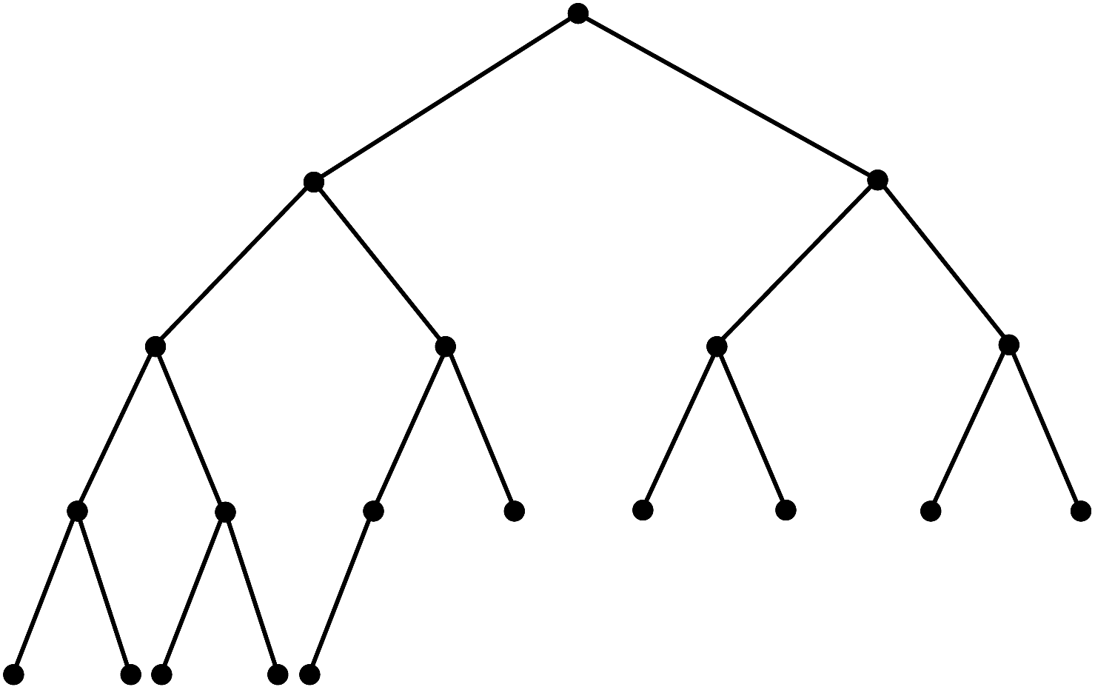
Figure 10-8 A complete binary tree

Slide 19
Another definition:
▣ A binary tree of height h is complete if
All nodes at levels <= h – 2 have two children each, and
When a node at level h – 1 has children, all nodes to its left at the same level have two children each, and
When a node at level h – 1 has one child, it is a left child

Slide 20

▣ A binary tree is balanced if the heights of any node’s two subtrees differ by no more than 1
▣ Complete binary trees are balanced
▣ Full binary trees are complete and balanced

Slide 21

▣ The balance factor of a binary tree is the difference in height between it left and right sub-trees.
▣ Let :
height of left sub-tree be H_{L}
and height of right sub-tree be H_{R}
Then the Balance factor (B) = H_{L} -H_{R}

Slide 22

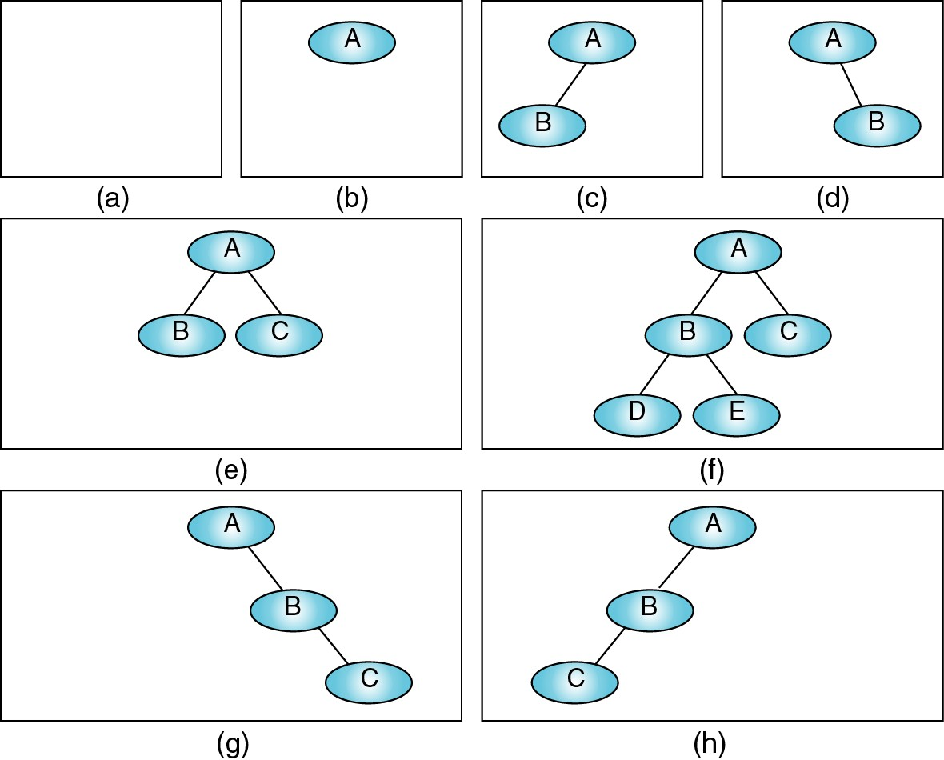

Slide 23

▣ General: Operations that
Insert data into a data collection
Delete data from a data collection
Ask questions about the data in a data collection
▣ Position-oriented ADTs: Operations that
Insert data into the i^{th} position
Delete data from the i^{th} position
Ask a question about the data in the i^{th} position
Examples: list, stack, queue, binary tree

Slide 24
▣ Value-oriented ADTs: Operations that
Insert data according to its value
Delete data knowing only its value
Ask a question about data knowing only its value
Examples: sorted list, binary search tree

Slide 25


Slide 26

▣ A full binary tree of height h ≥ 0 has 2^{h} – 1 nodes
▣ The maximum number of nodes that a binary tree of height h can have is 2^{h} – 1
▣ The minimum height of a binary tree with n
nodes is ⎡log₂(n+1)⎤
▣ Complete trees and full trees have minimum height
▣ The maximum height of a binary tree with n
nodes is n

Slide 27
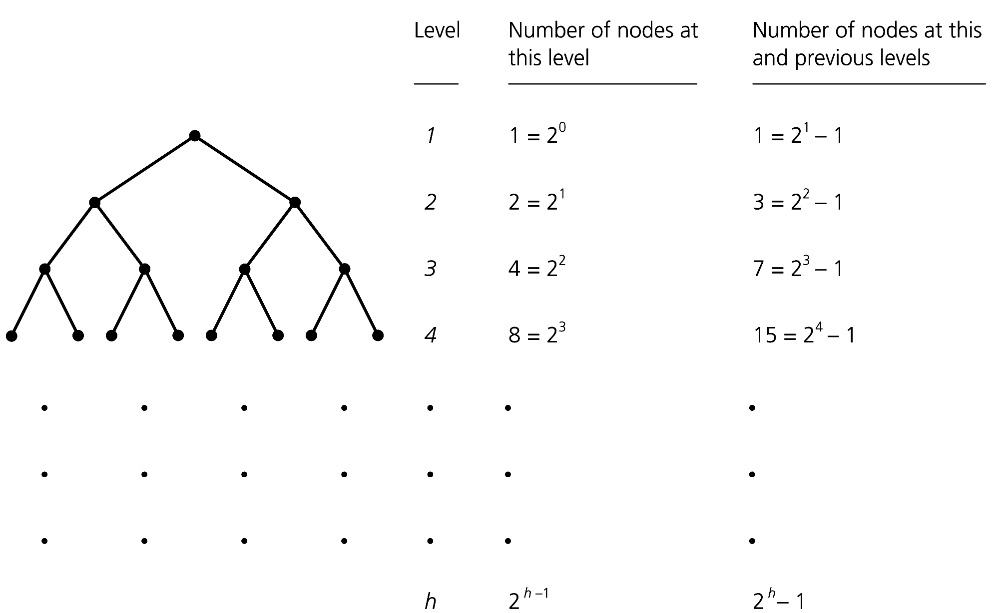
Figure 10-32 Counting the nodes in a full binary tree of height h

Slide 28

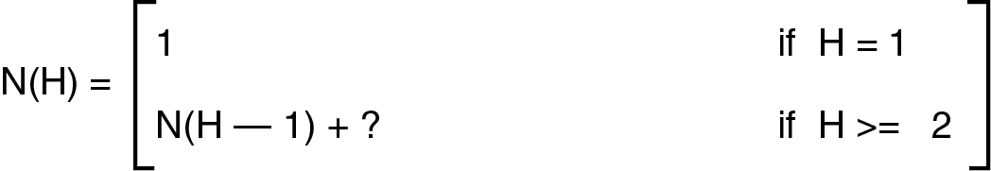
▣ In the following recursive definition of the maximum number of nodes based on the height of a binary tree. Replace the question mark with the proper value.

Slide 29

▣ What information is needed to represent a binary tree?
▣ What is it composed of?

Slide 30
▣ For every node in the tree we should keep track of:
Data
Left sub-tree
Right sub-tree
▣ Write a C++ structure that could represent a binary tree node

Slide 31
▣ Some array-based representations for binary trees exists. can you think of any?

Slide 32

▣ Tree traversal requires that each node of the tree gets examined (process or visit) once in a pre-defined sequence.
▣ Two general approaches are:
Depth first search (DFS)
Breadth first search (BFS)

Slide 33

▣ Process all the descendents of a child before going to the next child.
▣ There are three tasks that are performed when traversing:
Visit (V)
Traverse Left (L)
Traverse Right (R)

Slide 34

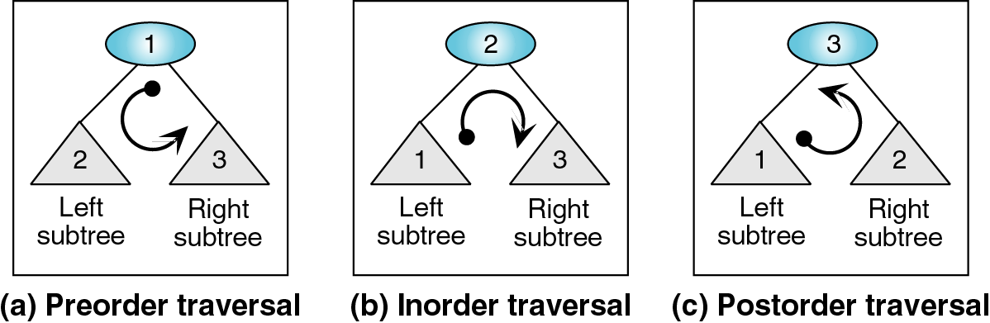
▣ Preorder traversal (VLR)
▣ Inorder Traversal (LVR)
▣ Postorder Traversal (LRV)

Slide 35

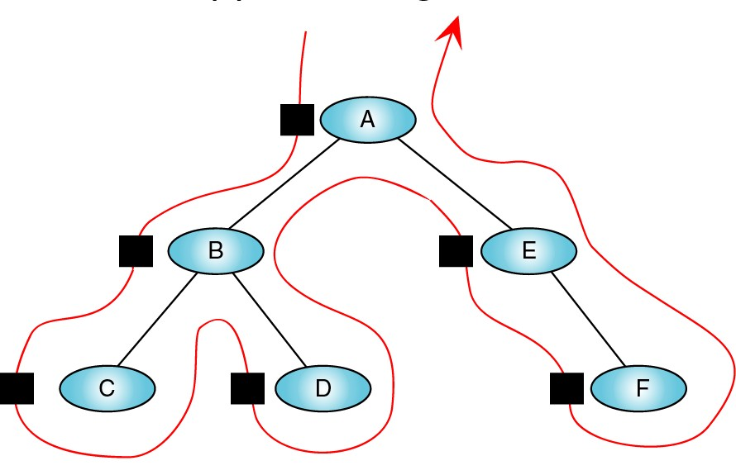
Preorder (node* root) if(root != NULL)
visit(root->data) Preorder(root->left) Preorder(root->right)

Slide 36

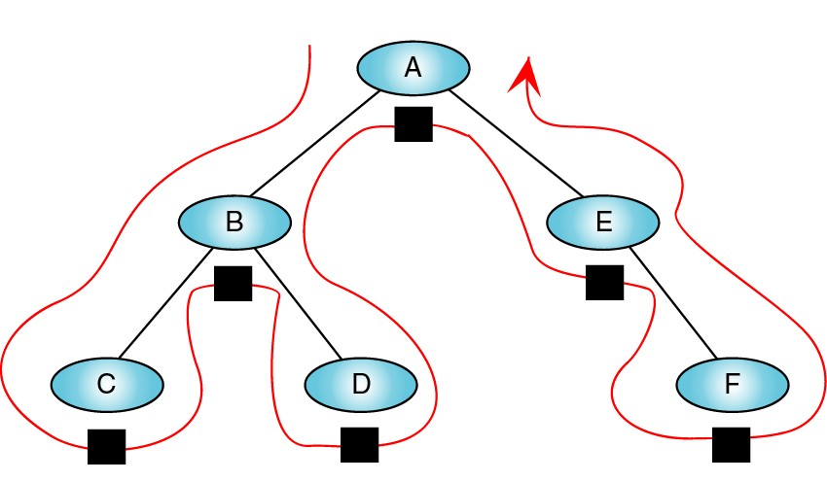
Inorder (node* root) if(root != NULL)
Inorder (root->left) visit(root->data) Inorder (root->right)

Slide 37

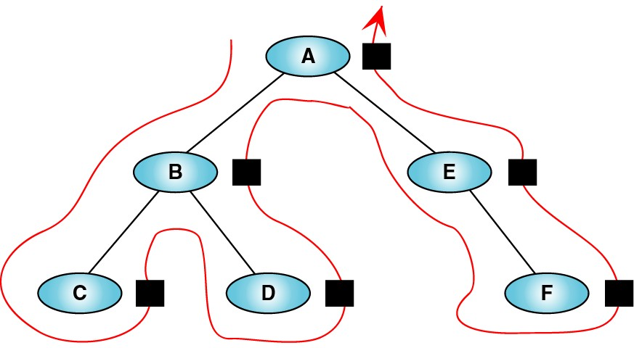
Postorder (node* root) if(root != NULL)
Postorder (root->left) Postorder (root->righ visit(root->data)

Slide 38

▣ Visit each node level by level
▣ What data structure can be used?

Slide 39

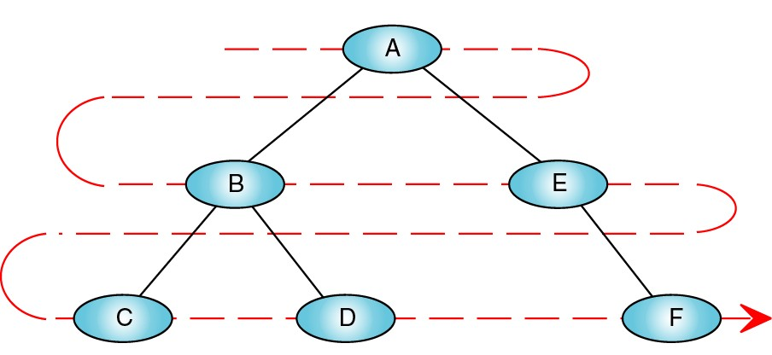
Level-order (node* root) queue Q Enqueue(root)
while( Q is not empty) enqueue(children of root) dequeue(head) visit(head->data)

Slide 40

